Slide 1
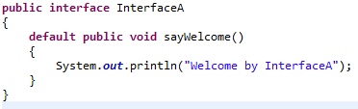
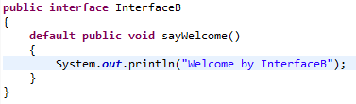
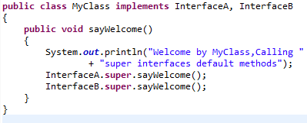
Method Overriding
implements
implements
MyClass myClass = new MyClass();
myClass.sayWelcome();
We can use the super keyword to invoke a default method in both classes and interfaces.

